Slide 1
SDLC for Beliram Parimal Co. Ltd
Agile Model
Presenters:
Ruthu Rajendra, Daniel Yang, Samantha Goh, Chirag Radhakrishna

Slide 2
Background of Beliram Parimal Co. Ltd
A Software Engineering start-up consisting of 50 developers.
The company does not have processes in place.
The company is developing an E-Commerce platform.

Slide 3
AGILE MODEL
Definition: Agile is an iterative and flexible approach to software development.
Focus: Prioritizes customer collaboration, adaptability, and rapid delivery of functional product increments.
Process:
Divides project into sprints (short development cycles).
Continuous Feedback: Each sprint allows to review progress and provide feedback.
Self-Organizing Teams: Teams work autonomously, with consistent stand-ups to align on progress.

Slide 4
AGILE MODEL
Fast Adaptation:
Startups often face rapidly changing requirements. Agile lets us pivot quickly based on new customer needs or market shifts.
Frequent Product Delivery:
Agile sprint structure allows us to release updates regularly, keeping our product evolving and visible to users.
Enhanced Collaboration:
With 50 developers, Agile organizes us into small, focused teams, promoting teamwork and clear communication.
Improved Quality:
Continuous testing and feedback within each sprint help catch issues early, improving product quality with each release.
Customer-Centric:
Agile involves stakeholders and customers regularly, ensuring our product aligns with real user needs and feedback.

Slide 5
The Phases of SDLC
Requirements Gathering - Define business and user needs, focusing on essential e-commerce features like product catalog and checkout.
Sprint Review - Review completed features with stakeholders after each sprint, gathering feedback for adjustments.
Design - Create user flows, layouts, and system architecture to ensure a seamless shopping experience.
Development/Implementation - Build and integrate front-end and back-end features, iterating as needed.
Testing - Validate functionality, security, and usability, ensuring a smooth and secure checkout process.
Evolution - Continuously update and improve the product based on feedback and usage analytics.

Slide 6
Requirements
Roles
Project Manager (PM):
Facilitates discussions with stakeholders to gather and clarify requirement specifications.
Stakeholder:
Provides input during discussions and has the final say on all requirements due to the small company structure.
Signs off on requirements after review to ensure alignment with business objectives.
Documentation
Comprehensive documentation of requirement specifications will be created to serve as a reference throughout the project lifecycle.
Review Process
Requirements Review:
Ensure all requirements are traceable: Each requirement can be linked to corresponding design and implementation stages.
Ensure all requirements are testable: Each requirement is defined clearly to facilitate verification through testing.

Slide 7
Requirements
Sign-Off Protocol: The stakeholders will approve the gathered requirements ensuring alignment with business goals before proceeding to the next phase.
Documentation
Requirement Document: Outlines all functional (features) and non-functional requirements
User Stories and Acceptance Criteria: Describes individual feature requirements from an end-user perspective.
Use Case Diagrams: Visual representations of system interactions, helping to clarify requirements.
Review and Validation
Traceability: Ensure each requirement is linked to business objectives.
Testability: Requirements should include criteria that can be objectively tested.
Completeness and Clarity: Ensure all requirements are unambiguous and cover all expected functionality.

Slide 8
Roles and Responsibilities
Product Owner: Defines product vision and is responsible for representing stakeholders’ interests.
Scrum Master: Facilitates Agile processes, manages obstacles and promotes team collaboration.
Development Team: Cross communication between teams is necessary for coding, design (UI), and testing within each sprint.
Stakeholders: Involved in sprint reviews, providing feedback and refining product vision.

Slide 9

Sprint review
Agile sprints involve conducting development and testing in short cycles. There will be weekly meetings for developers, and meetings with stakeholders will be scheduled upon reaching critical phases.
Gates are checkpoints to ensure alignment and progress during the product life cycle.
Backlog Refinement Gate
Sprint Planning Gate
Release Planning Gate
Increment Gate
Prioritize and finalize the backlog items
Decide on sprint goals for current sprint (Requirements approval, Design approval, Development completion, testing completion, etc.)
Review readiness for release
Accepts or rejects sprint deliverables based on acceptance criteria.
Product Owner
Stakeholders
Development Team
Scrum Master
Notes:
Agile sprints are time-boxed development cycle during which a cross-functional team works on a specific set of prioritized tasks. At the end of each sprint, sprint reviews are conducted through meetings to demonstrate the work completed as well as gather feedback from stakeholders, customers and team members.
Also known as phase gates, they are decision points that occur at the end of each phase or major milestone. These four gates (explain): serve as quality checkpoints where the project is evaluated before moving on to the next phase, helping to ensure project is on track + meets requirements and standards.

Slide 10
Design
As part of the agile development model adopted, each constituent of the e-commerce platform is to be implemented as an independent module (service). Each module can interact with the other modules while also being able to provide a functionality or service to each other.
Communication among modules is to be achieved through APIs.

Slide 11
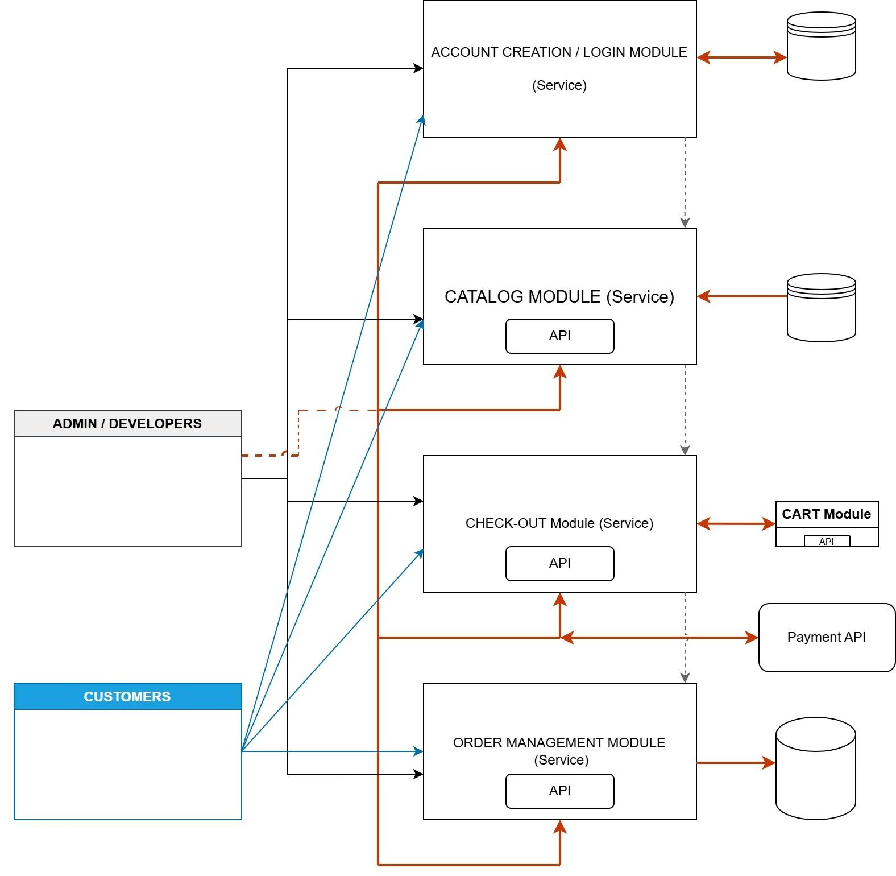
Platform Architecture

Slide 12
Security Needs-
Data Security.
Application Security.
Operating System Security.
Network Security.
Example:
Data Security requires that customer information including credit card details and other payment information be secure and protected from malicious users / hackers.

Slide 13
Design Traceability
Requirement | Design Element
Product Catalog: Display product details (price, images, description & seller information). | Catalog Module: Separate microservice handling product information storage, retrieval, and display. Connected via API to the front-end display.
User Authentication: Secure login and registration process. | Account Creation / Login Module: Handles login, registration, password encryption, and token-based authentication to protect the user-data.
Shopping Cart: Users can add, edit, remove and save items in their respective shopping carts. | Cart Module: Independent module that maintains cart state per user session. API-based communication to facilitate data flow with the catalog module.
Checkout Process: Securely process orders and ensure secure payments. | Checkout Module: Works with the cart module and payment API. Importance to data protection during payment processing.

Slide 14
Design Traceability continued…
Requirement | Design Element
Order Tracking: Allow users to view order status, order updates, recent orders, and order history. | Order Management Module: Manages order state, updates status and provides order history. Works with inventory database to manage stock levels.
Data Security: Ensure customer information, especially payment details & data, is secure. | Security Protocols: End-to-end encryption for sensitive information including payment details. Compliance with security assurance standards. Firewalls & DDoS Protection for network security.
User Interface: Simple, accessible user interface that provides efficient experience with responsive design.. | Front-End UI/UX Design: Prioritize accessibility and usability. Responsive design that is compatible across multiple devices/platforms.
Scalability & Maintenance: Readiness to handle potential growth. | Each module/service can scale independently which can support increasing market demand.

Slide 15
Development/Implementation
Discussion Topics:
Frameworks/Languages: Identify the technologies to be used.
UI/UX: Discuss design considerations and user experience.
Documentation: Outline documentation practices.
Standardization Procedures: Establish procedures to ensure consistency.
Sign-off:
All discussions and decisions signed off by the lead developer.
Work Division:
Split work into Frontend and Backend components.
Further divided into four parts as detailed in the architectural diagram.

Slide 16
Testing
01
Regression test plans - ensure new code do not negatively impact existing features
Functional test plans (verify functional requirements), non-functional tests
User Acceptance Test plan (end user requirements), Integration test plan (between modules and external systems)
Test Plans
02
Test Methods
Functional testing
Load and stress testing (load balancing)
Security testing (ie. encryption and data protection)
03
Acceptance Criteria
Clear definitions for each user story to meet e-commerce standards
Specific conditions that a feature must meet to be considered complete/ready for release.
Entrance exit criteria
04
Follow-up actions (if necessary)
Bug-fix sprints based on user feedback and performance data
Post-release monitoring
Documentation updates, training and knowledge sharing
Notes:
During testing phase, the team has identified 4 main areas to cover-primarily test plans, methods, acceptance criteria and follow-up actions.
When we think of test plans, a number of things came to mind like regression test plans, functional, non-functional, UAT as well as integration test plans.
Test methods
Acceptance criteria: user stories in requirements, Product Search and Filtering, entrance exit criteria.

Slide 17
Evolution
Maintenance Procedures:
Bug Fixes: Identify and resolve any issues discovered post-launch, ensuring minimal disruption to users.
Performance Monitoring: Regularly track system performance to identify areas for optimization.
Security Patches: Implement updates to address vulnerabilities, maintain compliance, and protect user data.
Customer Support Feedback Loop: Gather and analyze feedback from support teams to prioritize and resolve user-reported issues.

Slide 18
Evolution
Future Enhancements/Versions:
Feature Roadmap: Develop a roadmap for new features or enhancements based on user feedback, competitive analysis, and emerging trends.
Versioning Strategy: Implement a versioning system to track major updates and ensure clear release communication.
Scalability Planning: Plan for future growth by optimizing codebase, database, and infrastructure to support increasing user loads.
User Experience (UX) Improvements: Continuously improve user interfaces and workflows to enhance usability based on analytics and user feedback.

Slide 19
Evolution
Documentation and Training:
Maintenance Documentation: Maintain a detailed log of updates, fixes, and changes for troubleshooting and team reference.
Knowledge Transfer and Training: Provide training and resources for support and development teams to manage updates and new features effectively.

Slide 20
THANK YOU

